Slide 1
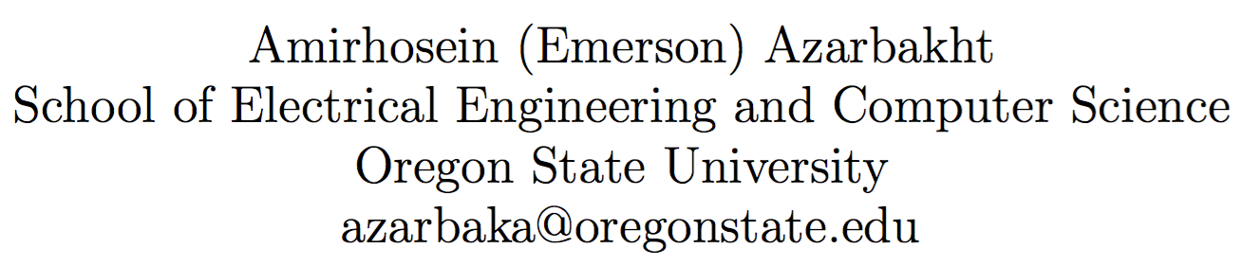
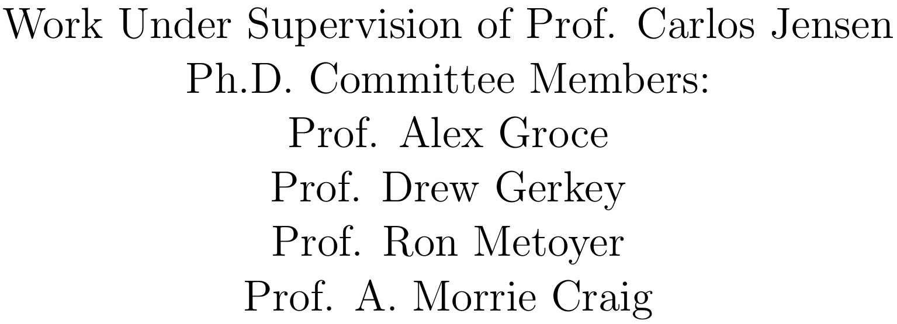
Longitudinal Analysis of Collaboration Graphs of Forked Open Source Software Development Projects

Slide 2

Great Projects
Assumption: You know what open source is.
Technical quality
duh?
Operational health
Ongoing ability to incorporate new code contributions and new developers, and to be responsive to incoming bug reports
Survivability
Ability to exist independently of any individual participant or sponsor; even if all of its founding members were to move on to other things

Slide 3
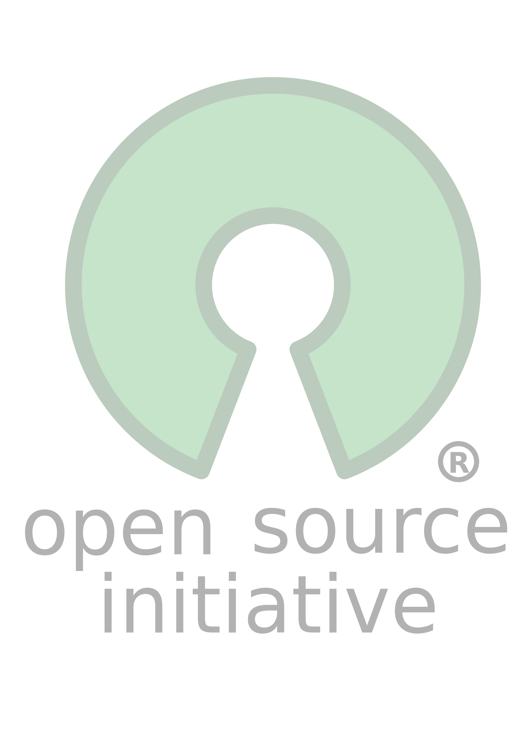
Open source is great but not all the time
Not everything works smoothly all the time in open source projects
Problems:
Uncertainty?
Will the vendor stick around?
“Industry is just as afraid of "fly-by-night" open source packages as it is of fly-by-night vendors that may not be around tomorrow.”

Slide 4
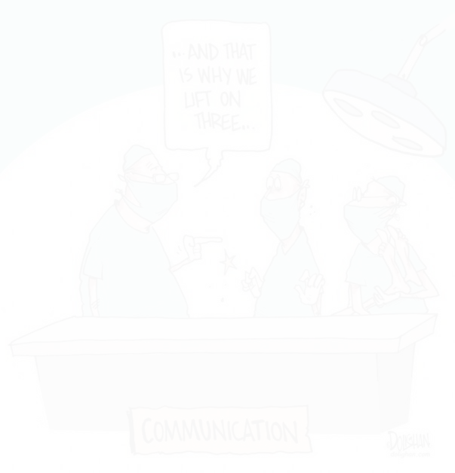

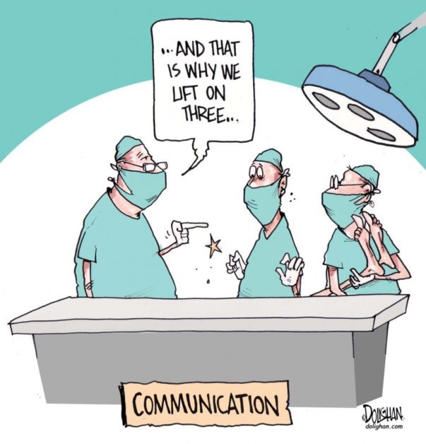
What is this about?
My research focuses on communication, collaboration problem, especially
What happens to trigger forking
Can we do something to predict when the community started to disintegrate

Slide 5
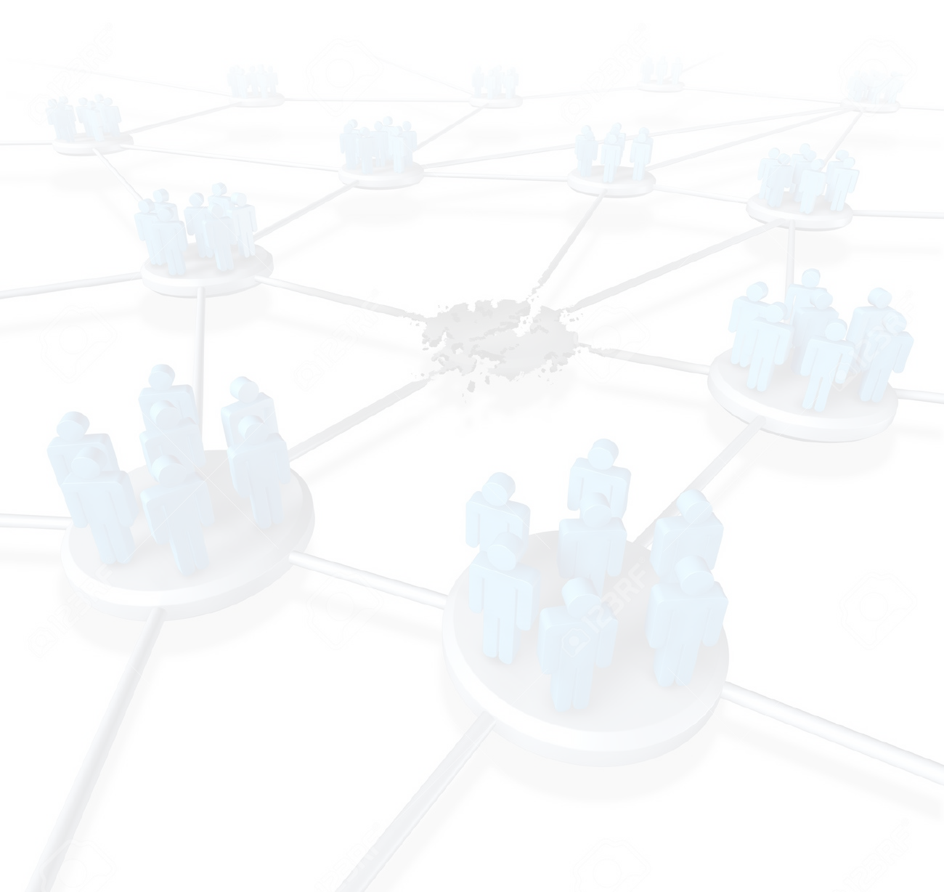
What is this about?
Big Picture
Developing complex software systems is complex
Software Developers (SD) interact
They can have same/different goals, communication styles, values
Interactions can be healthy or troubled
Troubled interactions cause troubled communities -> failure
Some of these failures manifest as forks
Failure affects many people; developers and users
Can we save troubled projects?

Slide 6

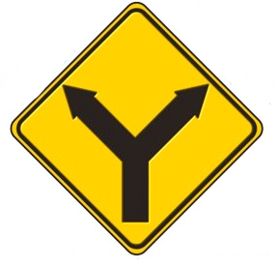
What is forking?
“When a part of a development community (or a third party not related to the project) starts a completely independent line of development based on the source code basis of the project.” (think "fork in the road".)
It can be undesirable:
Dilution of workforce
Flaming & unhealthy dynamics
Redundant work
}
people suffer
The more serious the threat of a fork becomes, the more willing people are to compromise to avoid it.

Slide 7

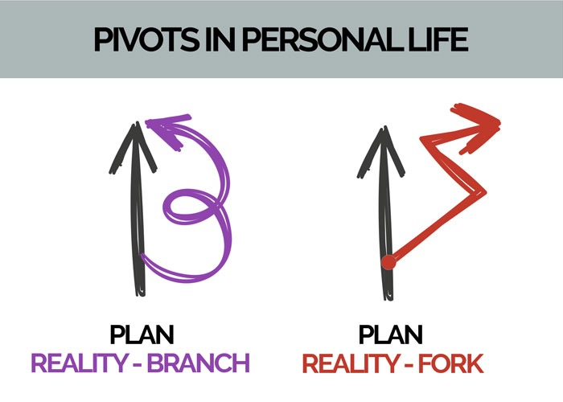

Forking Categories
Communities dissolve or evolve for a variety of different reasons:
Conflict-driven
Destructive
Lead to resentment
The forks are direct competitors, “you’re either with us, or against us”
Non-conflict-driven
Developers interested in exploring different functionalities, or different ways of doing things
Not necessarily creating an all-or-nothing type of thing;
Developers participate in multiple communities, as long as it’s a constructive work

Slide 8

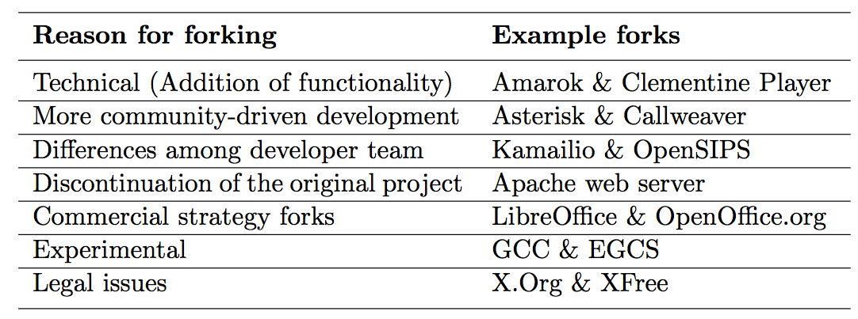
Why Projects Fork?
{
H.F.
{
Socially-related
U.F.

Slide 9

Whom are we helping?
Why this is an important question to look at?
Many depend on Open Source
Developer, sponsors, companies, stake-holders can make better-informed decision with the insights of our research
It is important to be affiliated or using a healthy live project, vs. a project that’s in the process of self-destructing

Slide 10
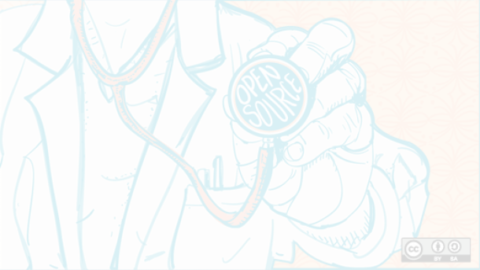
Social Health is Important
It’d be great if we could predict
Whether our community is likely to fork? or
When they are likely to fork?
So that we can design some sort of intervention, Or,
If you are an industry person, or even an individual contributor, to give you an objective external view of whether this is a community you want to get involved in, or whether you don’t, because getting involved, or using a software requires a level of investment.
For all these reasons, and for all these stake-holders, understanding the social health, and social health evolution of projects is really important.

Slide 11

Related Work
What we can know about FOSS | What we do not know
Identifying knowledge brokers [47] | Static point of view; People are important, but how do these roles change, how they move around around
Post-forking porting of new features [7] or bug fixes
Social structures and dynamics [10] | How these structures change through time
Identifying “key” events [1] | Compared only two snapshots; not longitudinal
Communication patterns [24] | Change through time?
Gap: Run-up to forks seldom studied

Slide 12

Research Goals
The objective is to be able to intervene, or evaluate the health
We need to figure out, are there key indicators left in the record, that can reliably be used to predict, or to identify problems?
Why these are important: Because if we know these, we could identify unhealthy dynamics and fix them before it’s irreversible.

Slide 13
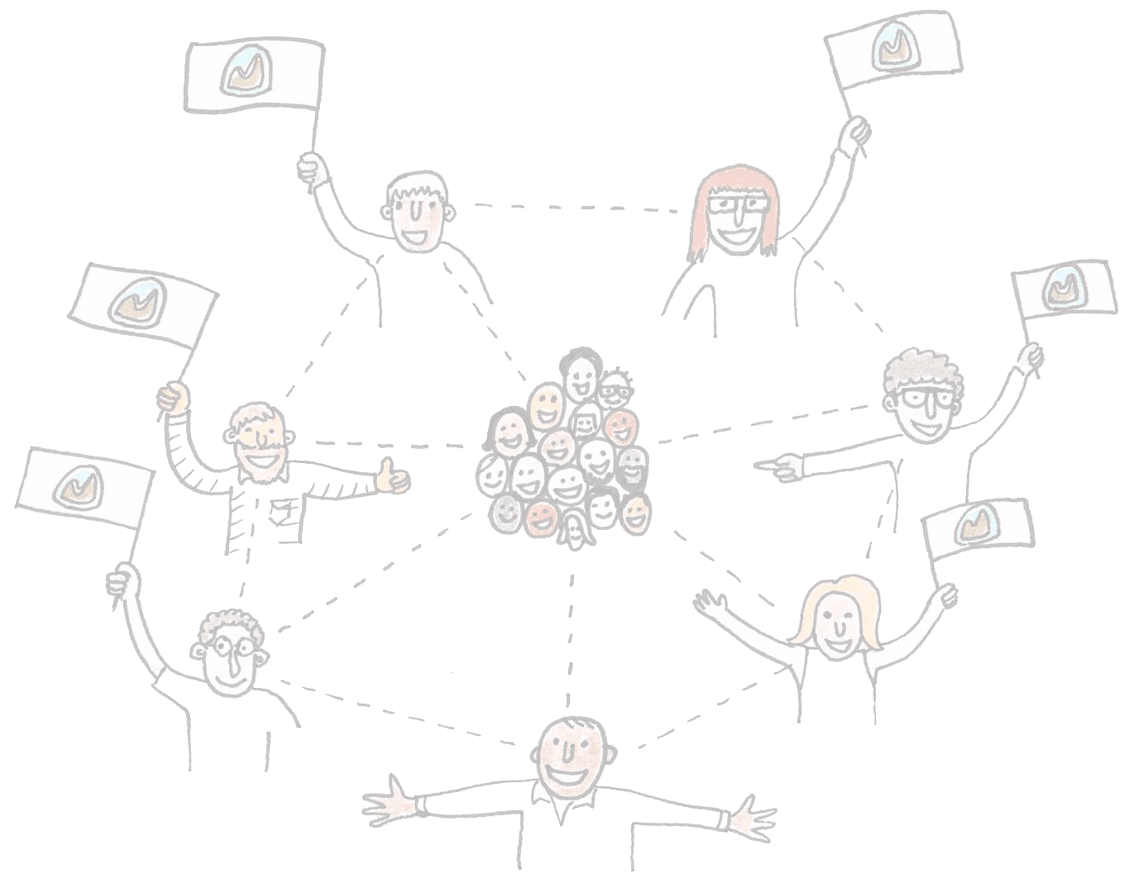
Developer Interactions
Occurs through mailing lists, IRC lines, comments, bug tracking system: This is where people talk, this is where communities form. Some of these are more important than others, for our analysis.
We primarily focus on mailing lists; Mailing List is the official record; this is where the important stuff gets discussed. This is the biggest public forum. You could have minor blow-ups in other parts, and that’s okay, if it’s important, it will migrate to the mailing list. Will be captured in the mailing list.
IRC: Not everyone participates, there’s no record, it’s ephemeral
Git logs: not everyone reads them, they are typically focused on what the code is at that point
Bug tracking system: not everyone reads them, they are typically focused on what the code is at that point

Slide 14

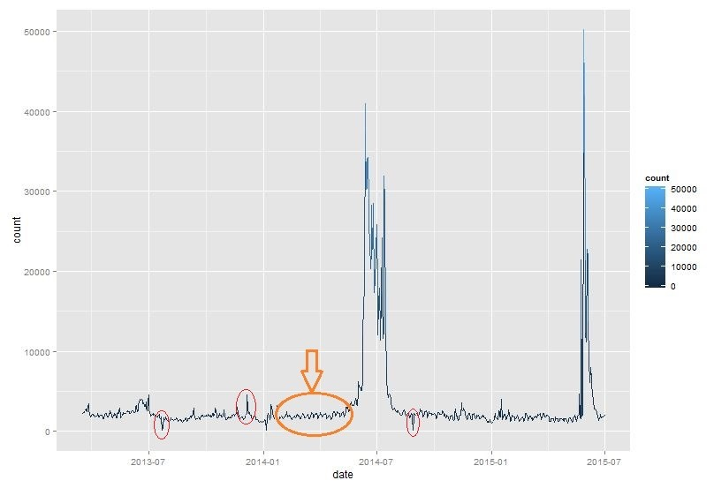

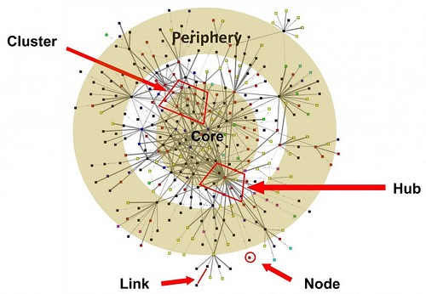
Methodology
I did the following two types of analysis:
Time series analysis of open source developers’ collaboration/communication sentiments
Social network analysis of open source developers’ interaction graphs

Slide 15
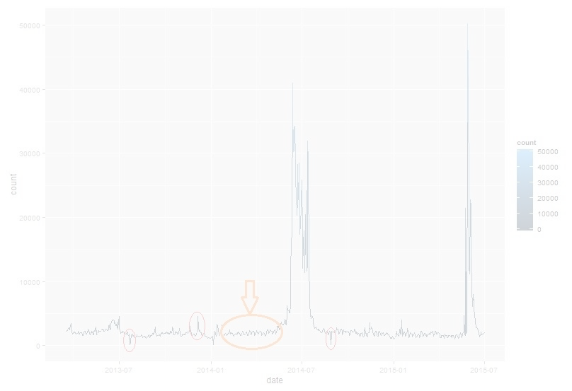
Methodology
Time series analysis of open source developers’ communication sentiments
Here’s my data:
The contents of the messages sent and received on the projects developers mailing list, for the time period of 10-month run-up to the fork.
Here’s why it matters:
The objective was to be able to intervene, or evaluate the health.
Anomaly detection of the time series analysis may be used by the project stakeholders/investors as key indicators left in the record, that can reliably be used to predict, or to identify problems among the developers, and intervene if need be.

Slide 16
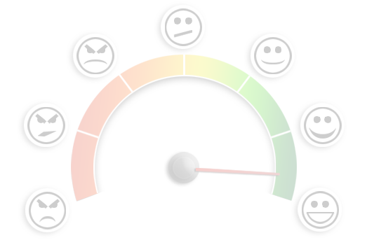
Sentiment Analysis
Sentiment analysis
Contents of messages sent/received by contributors
A time series of sentiments, to analyze

Slide 17
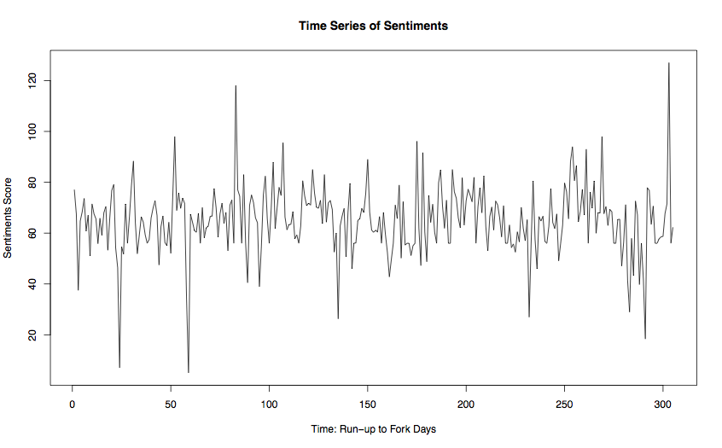
Time Series Analysis of Sentiments

Slide 18
Sentiment Analysis
To determine the attitude of a writer, the overall contextual polarity or emotional reaction to a document, interaction, or event
Using NLP, statistics, or machine learning methods to extract, identify, or otherwise characterize the sentiment content of a text unit
Used for
“Flame” detection
Bias identification in news sources
Identifying (in)appropriate content for ad placement
Analyzing trends
Identifying ideological bias
Targeting advertising/messages, gauging reactions, etc.

Slide 19
Sentiment Analysis: Time Series Analysis
Used in
Census analysis
Business forecasting
Disease incidence tracking
Understanding fluctuations in business sales
Airline's decision to buy airplanes bc of passenger trends and decision to increase/maintain market share
Monitoring unemployment rate; as an economic indicator used by decision makers

Slide 20
Sentiment Analysis: Time Series Analysis
Used to
To understand the past, and predict the future
Forecasting (predicting inference, a subset of statistical inference). assumes that present trends continue. This assumption cannot be checked empirically, but, when we identify the likely causes for a trend, we can justify the forecasting(extrapolating it) for a few time-steps at least
Anomaly detection
Classification (assigning a time series pattern to a specific category: e.g. gesture recognition of hand movements in sign language videos)
Query by content ~ content-based image retrieval

Slide 21
Sentiment Analysis: Time Series Analysis
Patterns
Trend: a non-periodic systematic change in a TS: a long-term change in the ‘mean’.
Can be modeled simply by a linear increase or decrease. (only if it's deterministic ~ it's non-stochastic).
Stochastic trend: seems to change direction at unpredictable times rather than displaying a consistent pattern (e.g. like the air passenger series); inexplicable changes in direction
Seasonal variation: a repeating pattern within a fixed period (e.g. each year)
Cycles: a non-fixed-period cycle (without a fixed period). Example: El-Nino
Residual: Most interesting component for analysis.

Slide 22
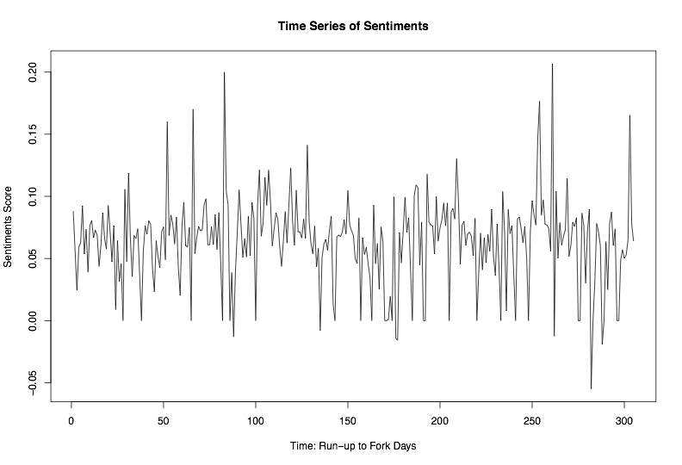
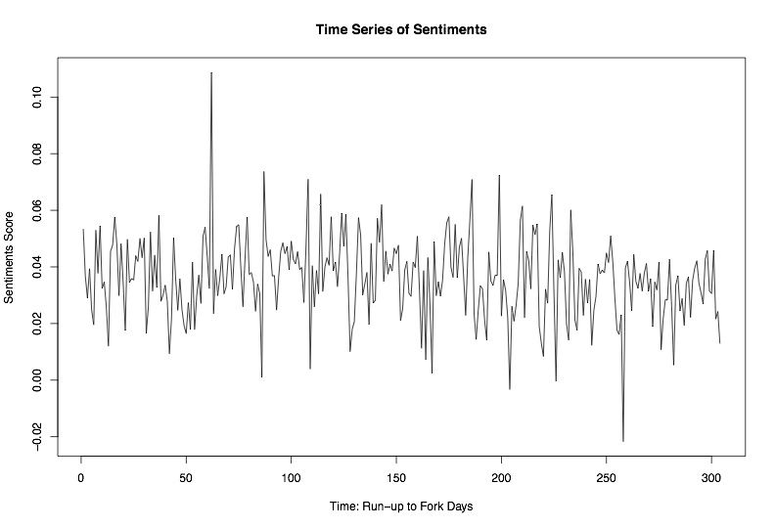
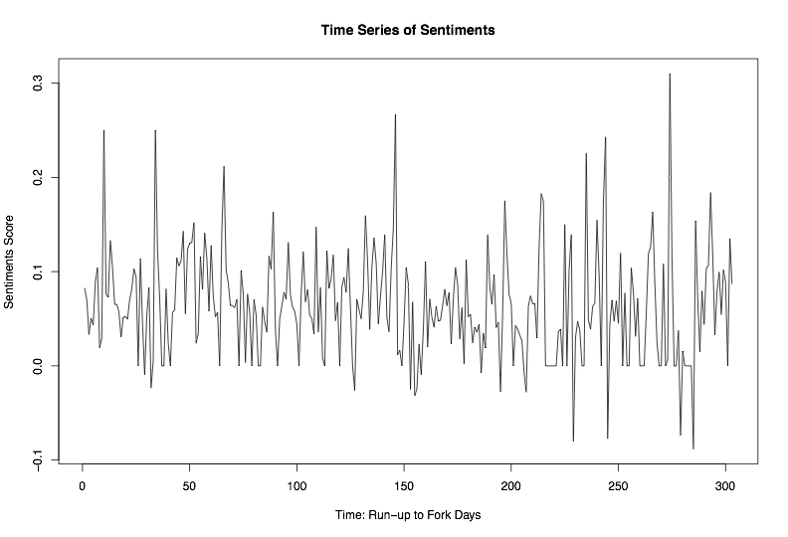
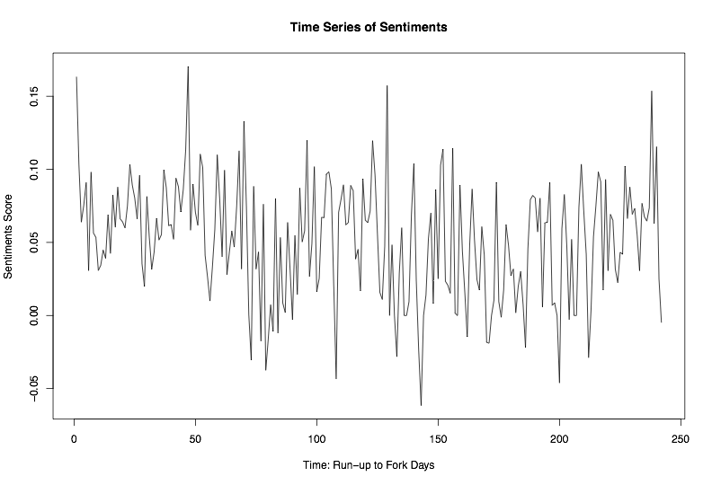
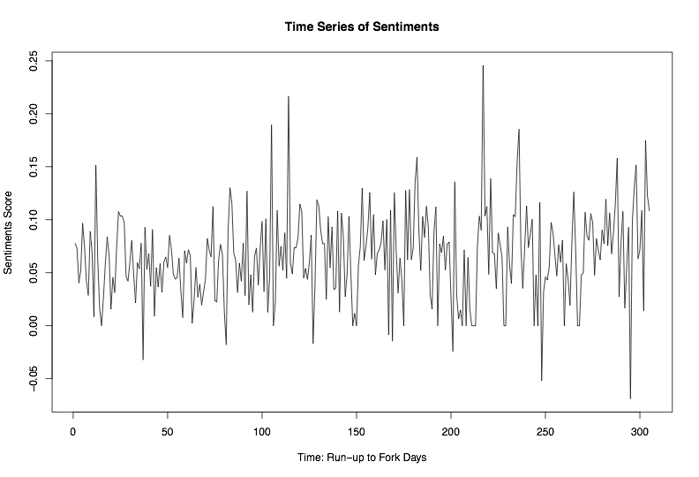
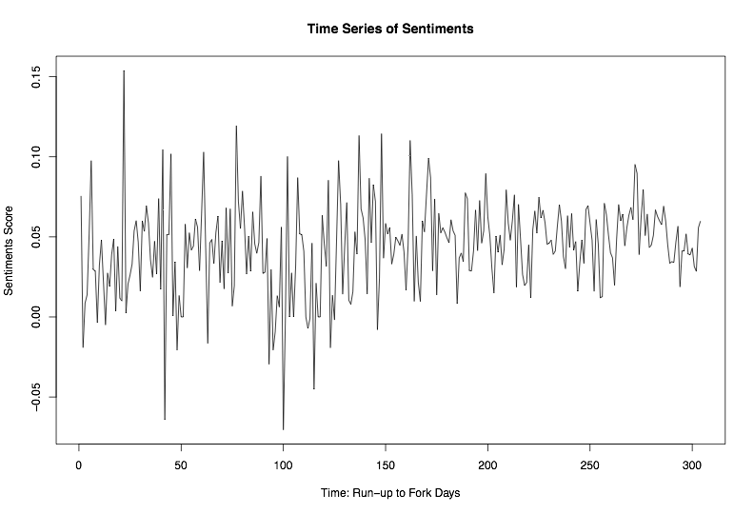
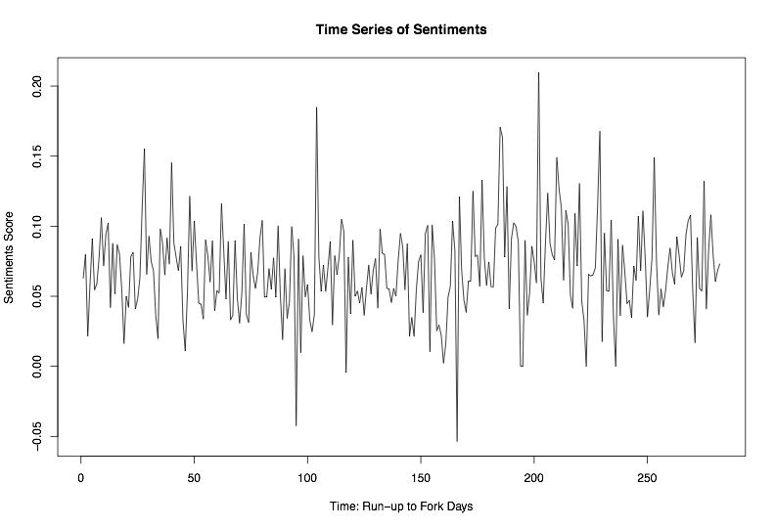
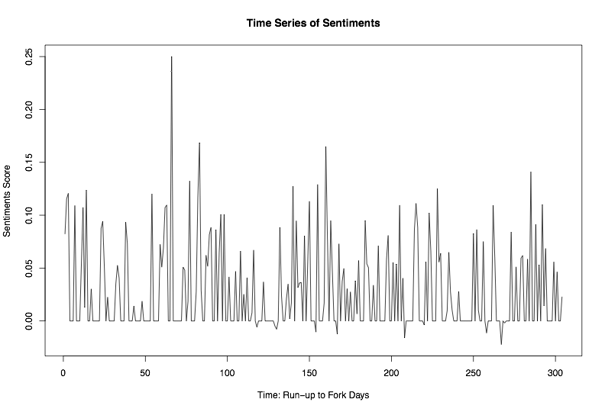
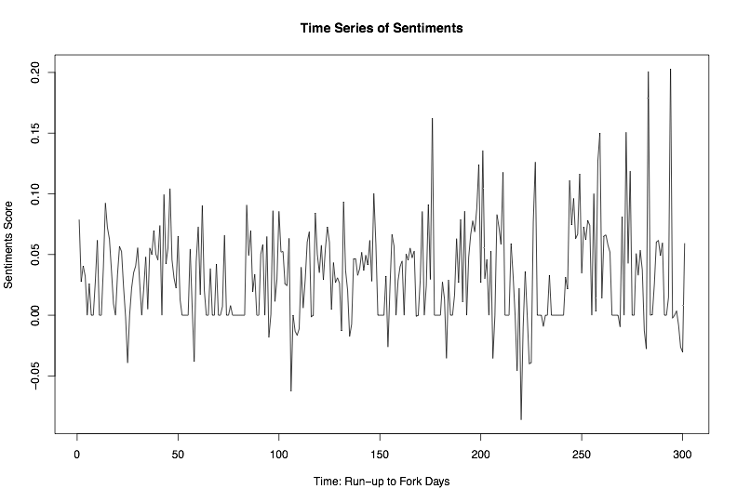
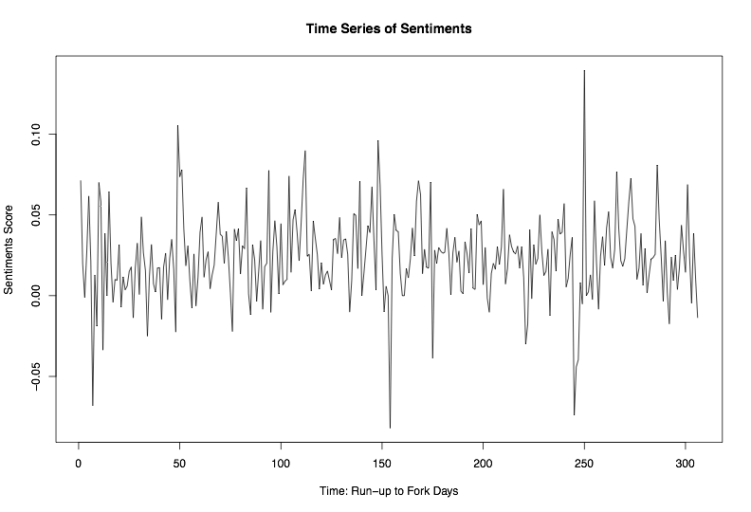
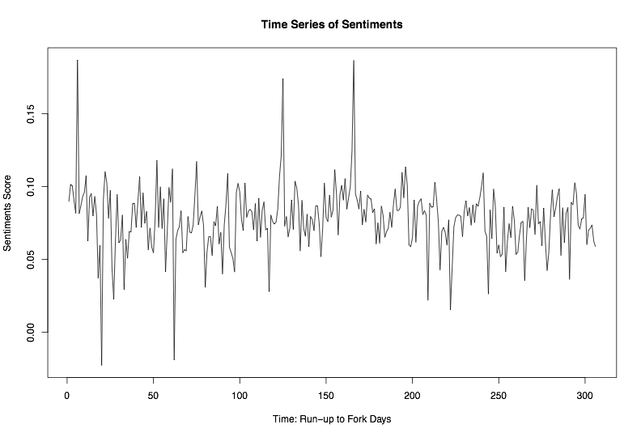
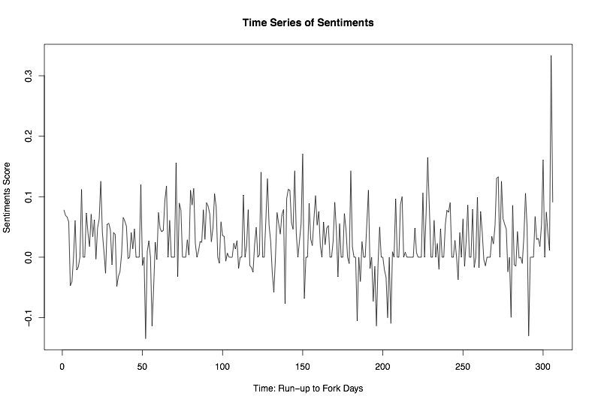
Time Series of Sentiments

Slide 23
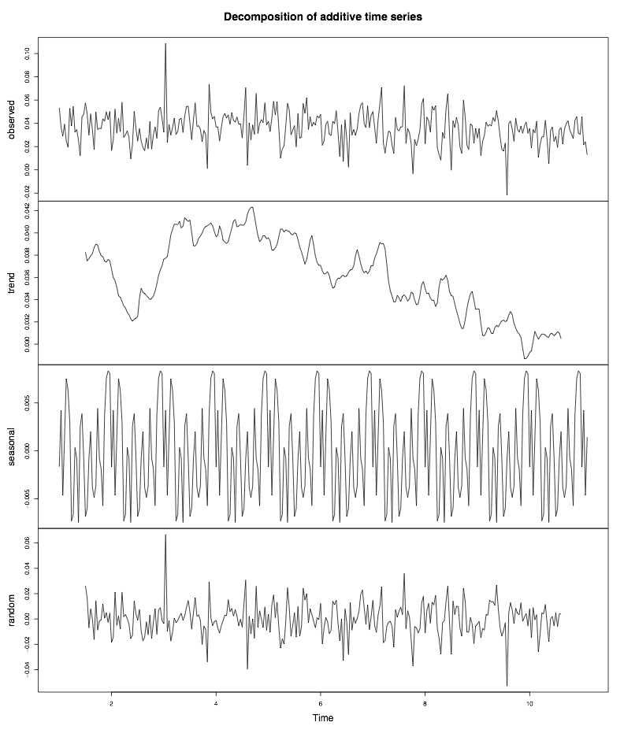
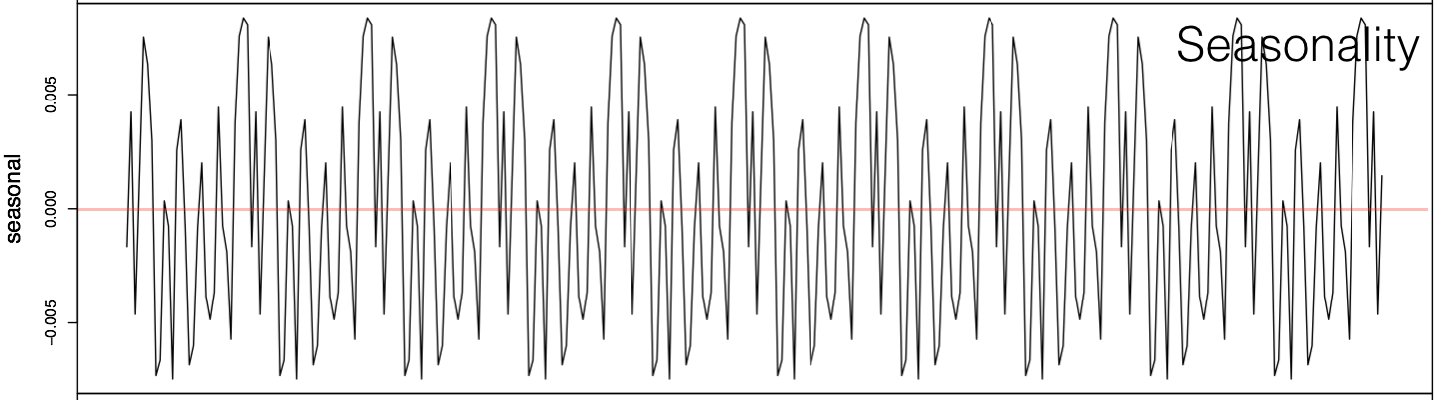
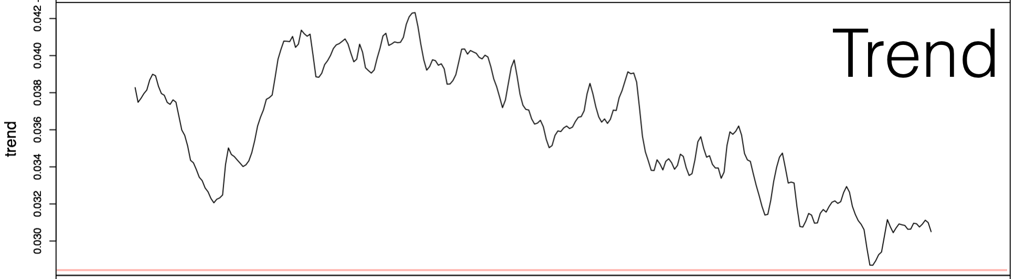
Time Series Analysis of Sentiments
Raw
Trend
{
Seasonality
Most interesting
Residual

Slide 24
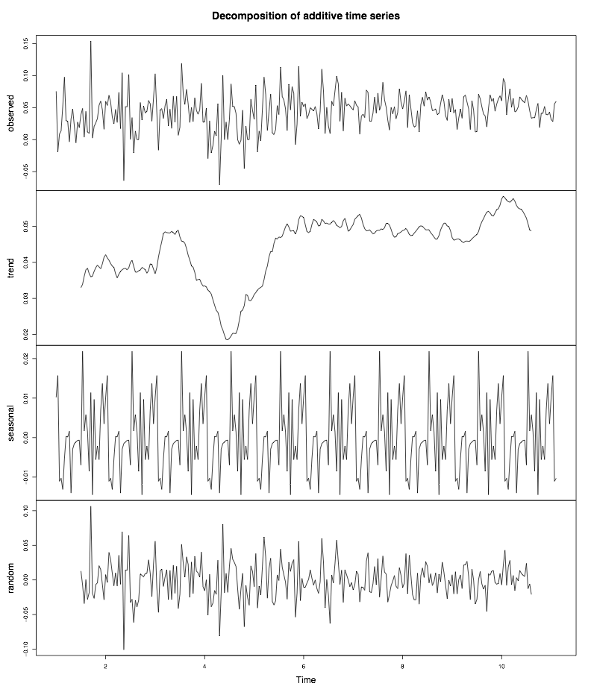
Time Series Analysis of Sentiments
Non-conflict-driven
vs.
Conflict-driven

Slide 25
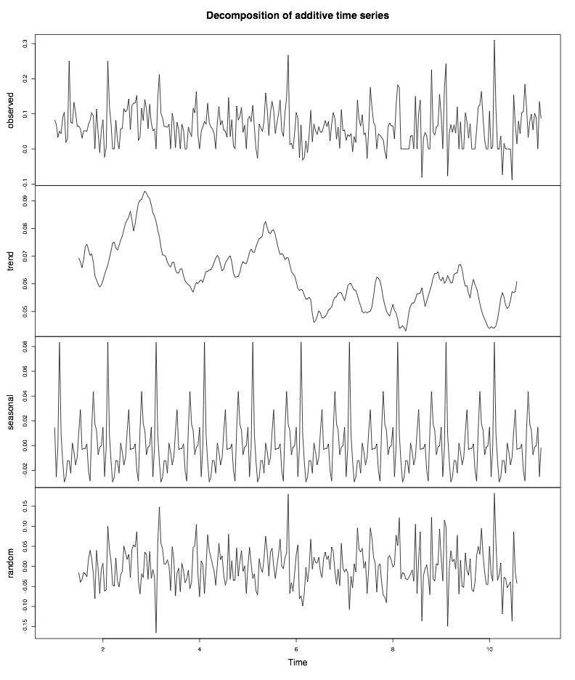
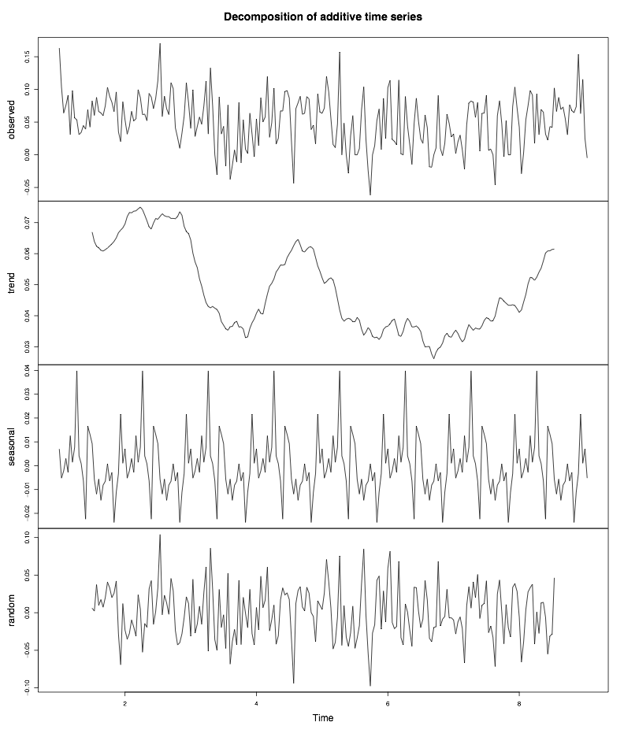
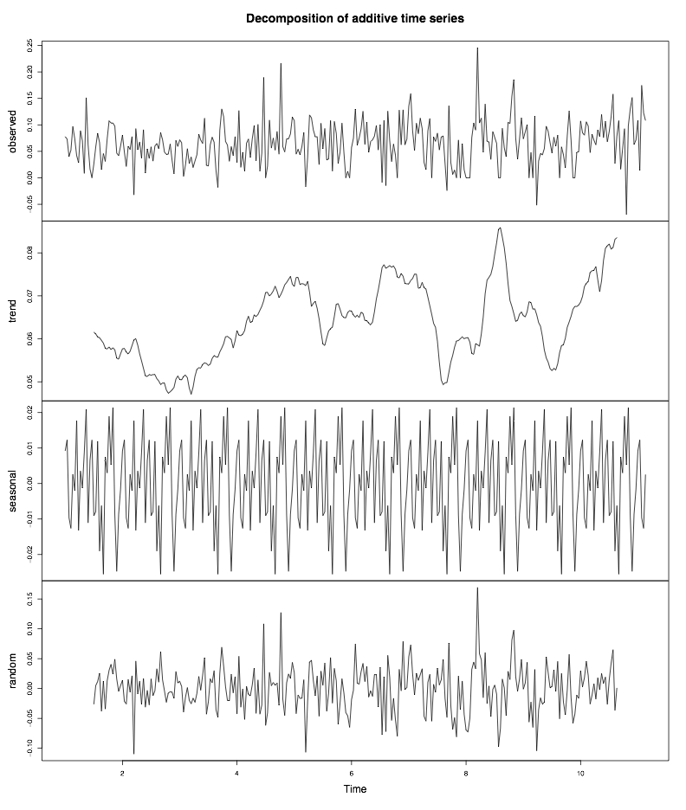
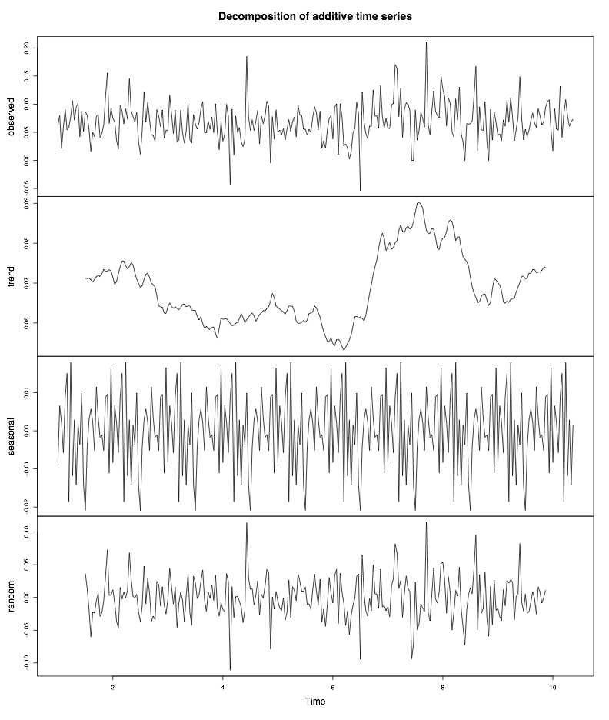
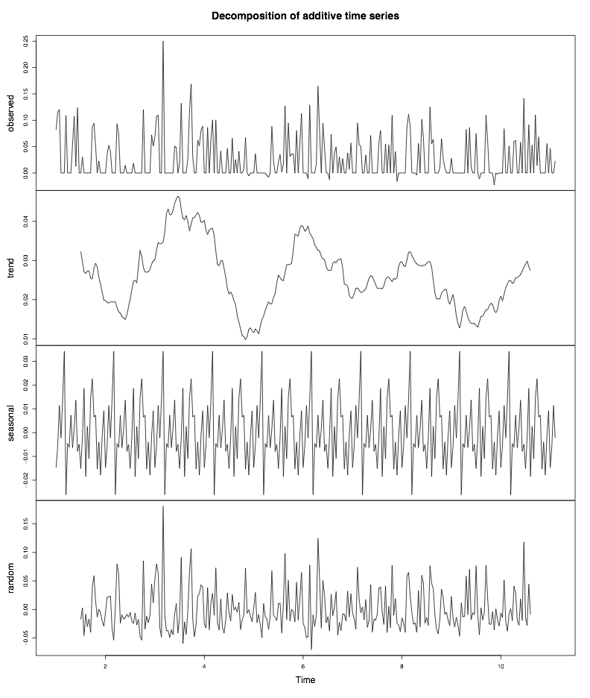
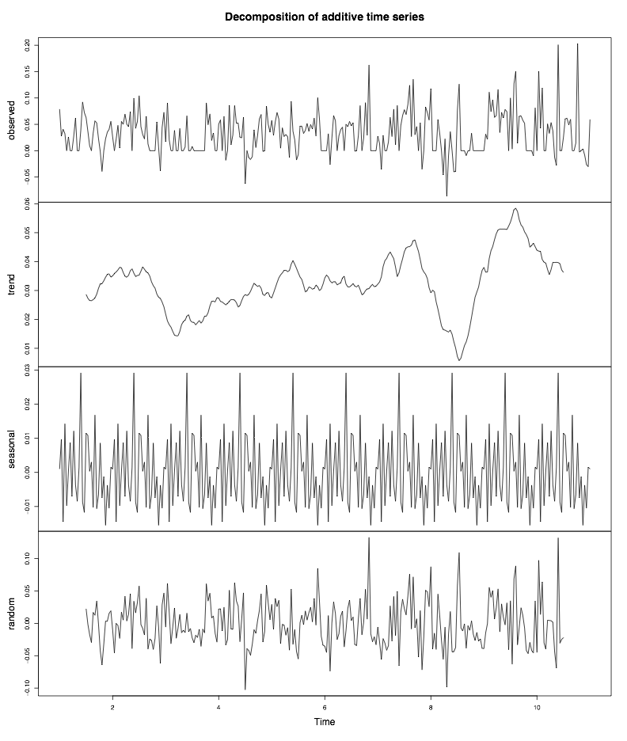
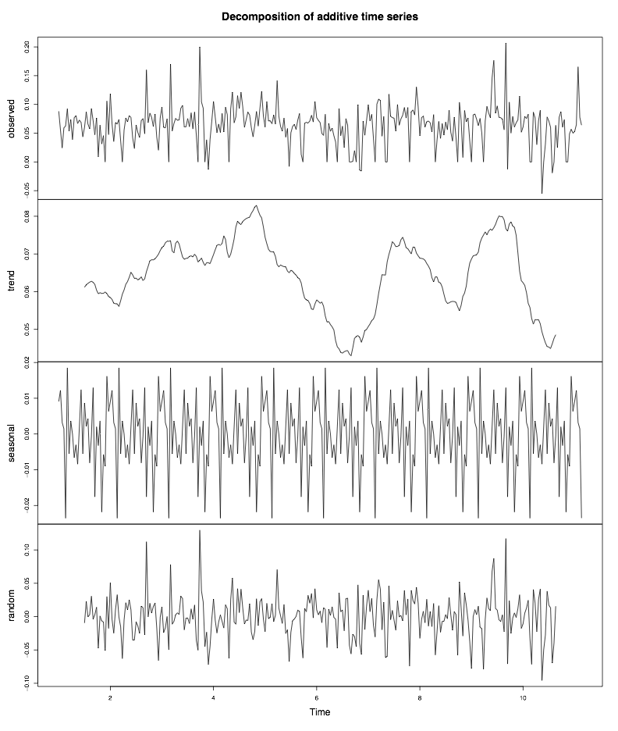
Time Series Analysis of Sentiments
{
{
Conflict-driven
Non-conflict-driven

Slide 26
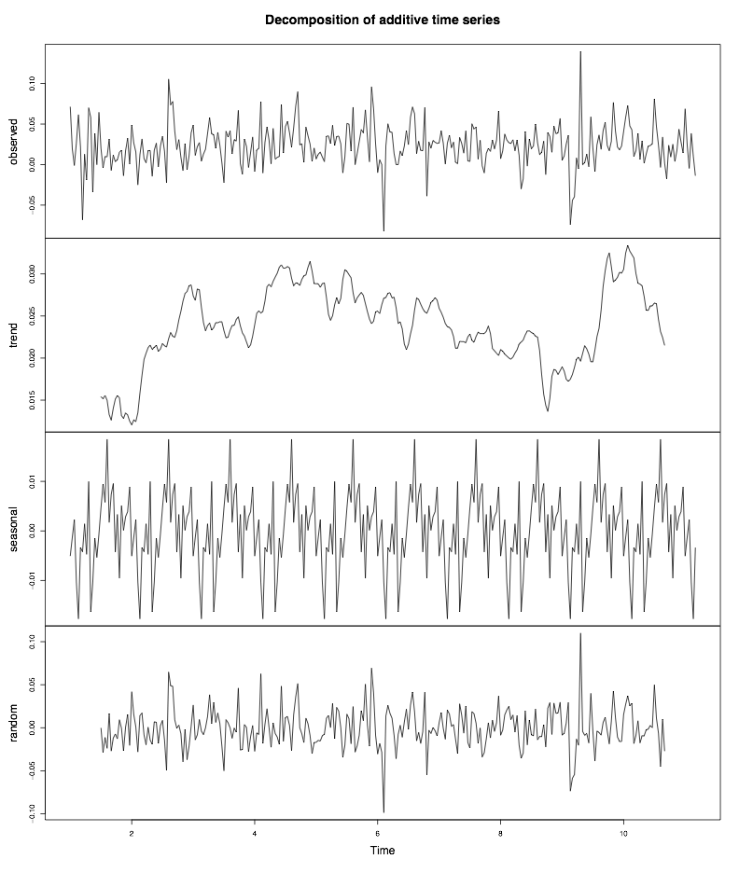
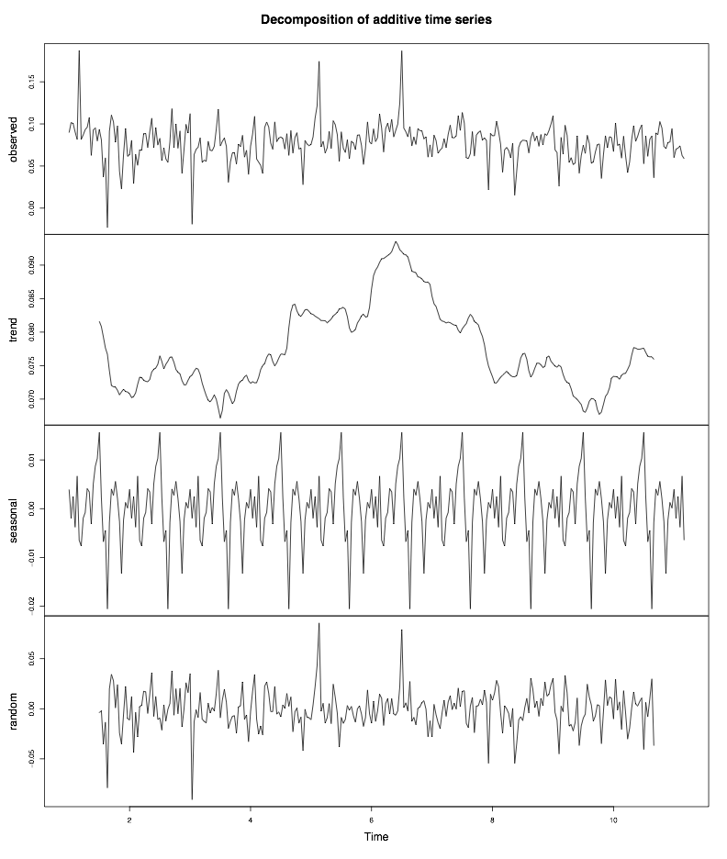
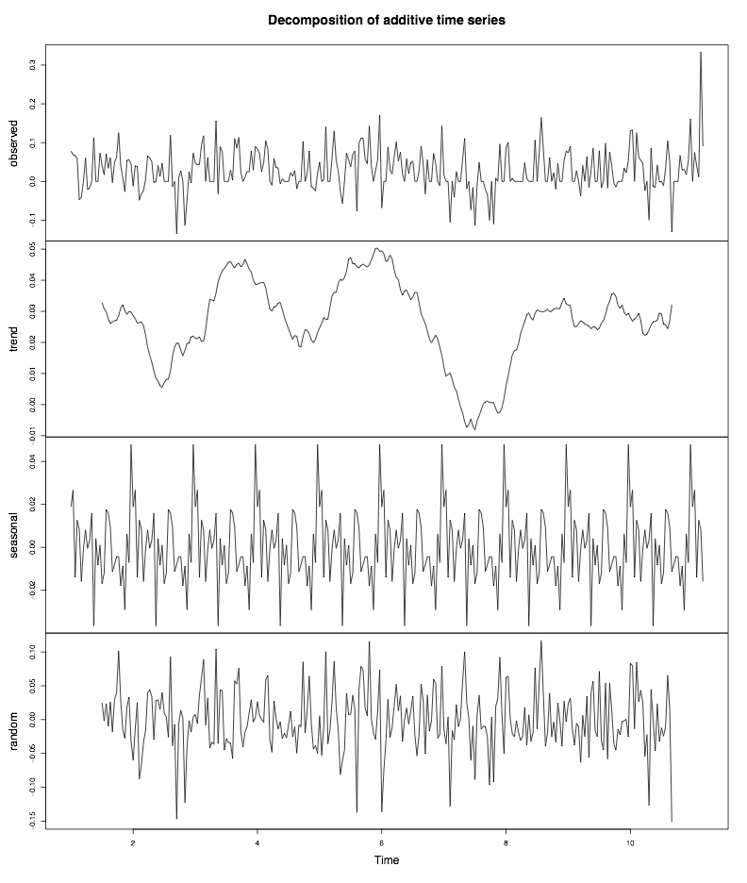
Time Series Analysis of Sentiments
{
No Fork

Slide 27
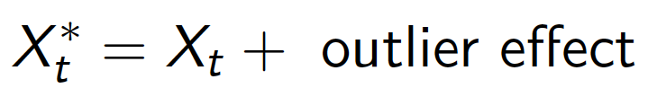
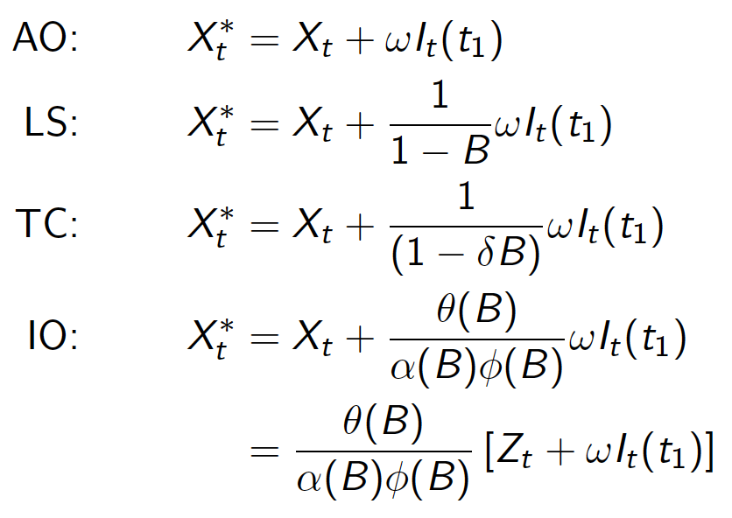
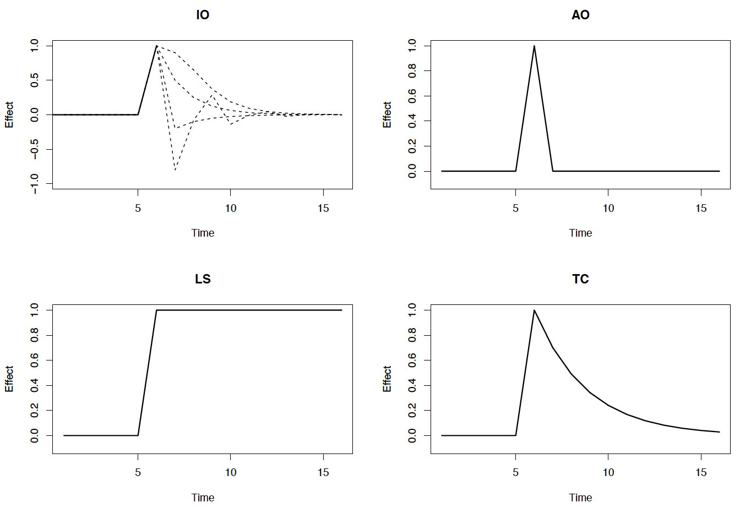
Time Series Analysis of Sentiments: Anomaly Detection
Observed series:
Four models for outlier effect:
Innovational outlier (IO)
Additive outlier (AO)
Level shift (LS)
Temporary change (TC)

Slide 28
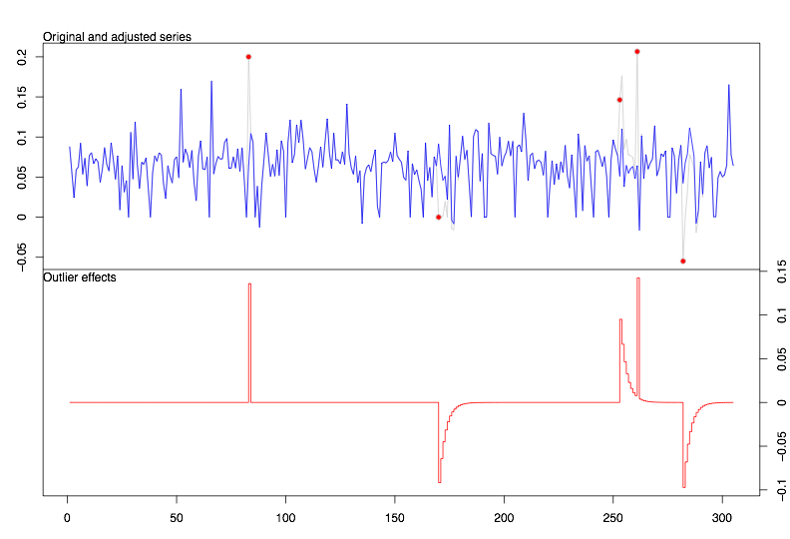

Time Series Analysis of Sentiments: Anomaly Detection
Fork date

Slide 29
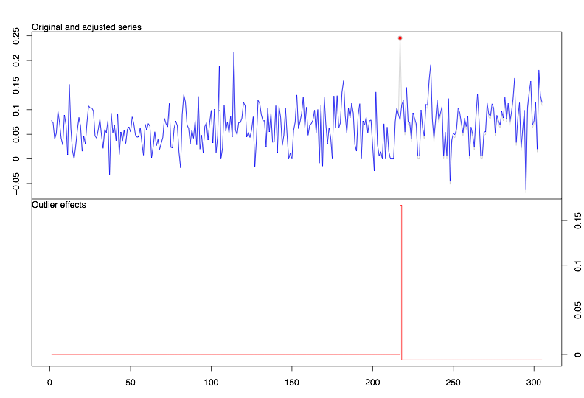
Time Series Analysis of Sentiments: Anomaly Detection
Fork date
Fork date
vs.
Normal, no negative outliers
Anomaly, negative outliers
Non-conflict-driven
Conflict-driven

Slide 30
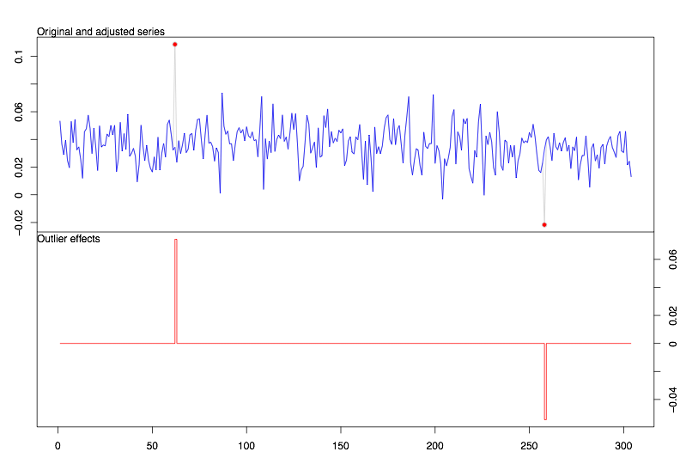
Time Series Analysis of Sentiments: Anomaly Detection: U.F.
Fork date
Fork date
Pre-fork negative outlier anomaly

Slide 31
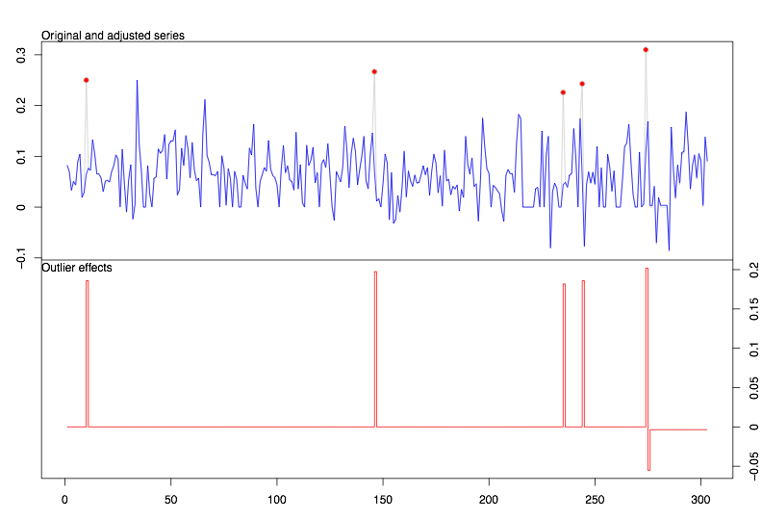
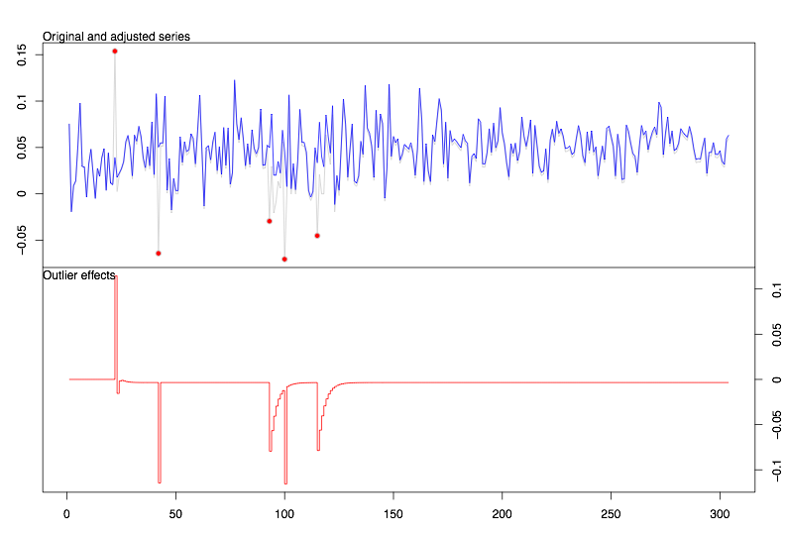


Time Series Analysis of Sentiments: Anomaly Detection: H.F.
no outliers detected
No immediate pre-fork negative outlier

Slide 32
Results
Time series analysis of open source developers’ communication sentiments
Here’s my data:
The contents of the messages sent and received on the projects developers mailing list, for the time period of 10-month run-up to the fork.
Here’s what I found:
Conflict-driven forks exhibited anomalies; time series analysis of sentiments shows the anomalies occur before the fork event
Non-conflict-driven forks did not suffer from pre-fork anomalies
Here’s why it matters:
The objective was to be able to intervene, or evaluate the health.
Anomaly detection of the time series analysis may be used by the project stakeholders/investors as key indicators left in the record, that can reliably be used to predict, or to identify problems among the developers, and intervene if need be.
Here’s the implications of what I found
It’s not great, but a good way of caring about an open source project that you rely on.

Slide 33
Person A: Forked! Person B: Really??!?!
'henning.westerholt@1und1.de' '2008-08-04 11:09:15' '[Kamailio-Devel] [Devel] SF.net SVN: opensips:[4568] tags/1.4.0/'
'Hi Dan, Hi Bogdan,
thanks for the short announcement of the existence of this fork - opensips.org. I was not aware of this, and i''m really disappointed. I think this is not the way to deal with this conflict. I had appreciated to know a little bit earlier of this plans, now i understand the events of the past months on this list and also the board somewhat better.
Henning'
Can we save troubled projects?

Slide 34
Person A: Forked! Person B: Really??!?!
'jason.penton@smilecoms.com' '2008-08-04 11:51:25' '[Kamailio-Devel] [Devel] SF.net SVN: opensips:[4568] tags/1.4.0/'
'..... so now we have SER, Kamailio and opensips
Surely, this is starting to confuse users and also dilute the number of developers working to ONE common goal. Is this really what we as developers and users want? Is this really what the majority codebase of the product needs? I''d be far happier having all the developers of these 3 projects working on ONE project!
just my 0.02 worth
Cheers
Jason
On Mon, Aug 4, 2008 at 11:45 AM, Julien BLACHE <jb at jblache.org> wrote:
> Henning Westerholt <henning.westerholt at 1und1.de> wrote:
>
> Hi,
>
> > thanks for the short announcement of the existence of this fork -
> > opensips.org. I was not aware of this, and i''m really disappointed. I
> think
>
> OK, now I''m really confused. A couple of important things have
> happened more or less behind the scene in the past months in this
> project, and I''d really like it if someone could sum up the current
> situation.
>
> JB.
>
> --
> Julien BLACHE <http://www.jblache.org>
> <jb at jblache.org> GPG KeyID 0xF5D65169
>
> _______________________________________________
> Devel mailing list
> Devel at lists.kamailio.org
> http://lists.kamailio.org/cgi-bin/mailman/listinfo/devel
>
-------------- next part --------------
An HTML attachment was scrubbed...
URL: http://lists.kamailio.org/pipermail/devel/attachments/20080804/e23a3db4/attachment.htm'
Could we know earlier?

Slide 35
Person A: Forked! Person B: Really??!?!
'abalashov@evaristesys.com' '2008-08-04 18:56:57’ '[Kamailio-Devel] [Kamailio-Users] 1.4.0 release plans,\n project matters'
'I would strongly concur with Darren here on all counts.
I don''t, of course, have any sort of inside perspective as I am not involved in development, so I can''t presume to judge the merits or veracity of the various justifications given for this adventure. Apart from Bogdan-Andrei''s brief treatment of the subject, explanations haven''t been particularly forthcoming to the community; this seems to be a back-room affair that is still playing out.
There are, certainly, times in the life of an open-source project where a code fork may be justifiable; irreconcilable differences over development methodologies, project management practices, and overall design philosophy and direction/roadmap may figure into these. Also, what Bogdan-Andrei has put forth concerning his freedom to pursue this undertaking in light of prevailing and officially codified open-source precepts is factually valid and logically ostensible.
Now, that having been said, from the perspective of a user contemplating the adoption of OpenSER in a serious industrial application, or worse, a businessperson who has sunk substantial investment into deployment of OpenSER, this is really, really bad.
Much of the value of open-source projects comes from the fact that despite the range of political characteristics potentially colouring the development and its management (from profoundly hierarchical, as in the case of the Linux kernel, to rather loose coupled and organic, as seems
to be the case with OpenSER), comes from certain rational expectations that one holds regarding their security, stability, consistency and continuity. Industry is just as afraid of "fly-by-night" open source packages as it is of fly-by-night vendors that may not be around tomorrow.
Generally, when one chooses to invest in a rather serious and evolving open-source solution like OpenSER, one expects the following things: 1. The project will be around next year, more or less in its present state. […]
2. Its development is coloured by a relatively consistent methodology; even if the original core developers no longer contribute heavily to the code base itself, their oversight, direction, vision, method and quality-control is realised in the activities of those to which that work has been delegated. The sources of that direction and influence must be relatively cohesive and clearly identifiable.
3. In the case of something relatively low-level and niche like OpenSER, a thriving ecosystem of first and third-party contributors and vendors of commercial support must exist. Nobody is going to trail-blaze without any sense of reliance on anybody in particular. This heavily depends on #2, and on the consistency of the project as a unitary thing.
4. The project will retain a unitary character as much as possible;
there will not be bewildering an array of species and subspecies of the
code which will contain varying degrees of features, quality control,
bug fixes, and developer and organisational affinities. All such
choices involve trade-offs that are unacceptable in serious work,
especially when the trade-offs involve some form of playing roulette,
gambling on the meritocratic superiority and pre-eminence of a
particular version and not another and its longevity.
...
This type of code work heavily upsets these expectations and decreases
overall confidence in the project, which, especially in open-source, is
so profoundly a function of the people behind it and the ecosystem it
cultivates.
How do I know whether the latest bleeding-edge modules that perform
low-level technical enhancements or fixups won''t be in OpenSIPS, but
ones which offer more high-level integration paths and business logic
interworking in Kamailio? What kind of compatibility can I count on if
I wish to switch?
How do I know that critical bugs applicable to pre-fork code in Kamailio
will be fixed in OpenSIPS, or vice versa? At the encouragement of Juha
Heinenen, I just submitted a bug report about a race condition on call
branching to the Kamailio Tracker. How do I know whether it''s going to
be addressed sooner in Kamailio or in OpenSIPS, if at all? What if this
type of issue is closer to Bogdan-Andrei''s core competency and interest
than that of the remaining Kamailio developers, or vice versa? Now I
have to engage in this type of guesswork and detect the political winds.
I shouldn''t have to do this as a user; I was counting on one
development team and one mission.
How do I know there won''t be more code forks or internecine feuds? If I
am a medium to large organisation with relatively high internal
technical capital, I may see an economic rationale in taking an existing
release and all maintenance of it in-house and *not* releasing the
changes back to the community (after all, too many "communities" to
choose from, if nothing else). Or I may release it as my own code fork
later, once it''s deviated enough. Both of these damage and undermine
the incipient ecosystem surrounding OpenSER.
Code works beget more code forks and more proprietary approaches by
shifting the mindset of users to a self-reliant approach as a matter of
pragmatic necessity; if I can''t really count on the project''s integrity
politically, there''s far less incentive to build business decisions
around it.
Open-source contributors are also going to be less enthused about
contributing to a landscape full of code branches, as they have to make
similar bets about their relative merits and significance.
As far as I can tell, OpenSER has a handful of core developers and one
to two dozen ancillary developers. This isn''t that big of a project
from an organisational perspective. Somehow, open-source projects much
bigger - with much more at stake - have managed to survive without this
type of feuding and forking. MySQL, the Linux kernel, Apache, and even
Asterisk to a relatively high degree, are all examples of projects with
hundreds to thousands of active contributors that do not seem to suffer
from these types of problems, which is why I consider them relatively
safe to invest in.
Once again, I am not berating either side of this issue; I don''t have
the perspective to judge. Likewise, I stand in awe and appreciation of
Bogdan-Andrei''s significant technical contributions to OpenSER and the
offerings Voice System is poised to make, and can appreciate the
possible legitimate reasons he may have for wanting to make this split.
But I think that I speak on behalf of the prevailing majority of users,
adopters, enthusiasts of and contributors to OpenSER when I implore you
guys to work your differences out, compromise, standardise, and merge
the code back into one project so that we can all continue to enjoy,
evolve and innovate with the best, most extensible, polymorphic and
featureful SIP server out there.
Cheers,
-- Alex
Darren Sessions wrote:
> I can''t tell you all how worrying another fork of SER or OpenSER is to me.
>
> I have worked, known, or at least met most of the people in SER ->
> OpenSER -> OpenSIPS groups in some fashion over the last five or six
> years starting back with Jiri and Bogdan at iptel.
>
> I obviously don''t understand what''s going on that could possibly cause a
> project fork but I think I can speak for a number of people as a
> former commercial support customer, present user, source tinkerer, and
> occasional consultant - when I say that this really does put a dark
> cloud over ALL of the projects.
>
> To start splitting up the core developers -again- between projects, to
> me, seems absolutely insane!
>
> This makes me extremely nervous going forward with either project and I
> will be (as most will be) watching closely as this situation continues
> to unfold and details emerge.
--
Alex Balashov
Evariste Systems
Web : http://www.evaristesys.com/
Tel : (+1) (678) 954-0670
Direct : (+1) (678) 954-0671
Mobile : (+1) (706) 338-8599'
Industry/sponsors afraid of uncertainty?

Slide 36
Person A: Forked! Person B: Really??!?!
'abalashov@evaristesys.com'
'2008-08-05 02:34:48'
'[Kamailio-Devel] [Kamailio-Users] 1.4.0 release plans,\n project matters'
'Bogdan,
Thank you for your reply.
You do raise a lot of good and constructive points. The overarching theme of my response to them is that because I am not privy to the interior of the project narrative, I do not have the knowledge to critically evaluate or authenticate a great deal of what you say. If the situation is as you suggest, then perhaps, indeed, you are doing a good and necessary thing. I can only give the perspective of an outsider.
That said, I offer a few inline replies, from that very vantage point:
Bogdan-Andrei Iancu wrote:
> to be honest I preferred not to put details about the arguments as I did > want people to think I''m pointing burning fingers or I''m blaming > something or somebody. Of the arguments are to be found on the > discussions from the board list, but this is not public.I can certainly understand appreciate the need to avoid public accusations or anything that could be construed as undermining anyone''s personal integrity.
The flip side to this conservative approach to publicizing internal affairs is that to the rest of us--those who are not project luminaries--it leaves the situation looking like some absurd, internecine feud replete with tribalism, factionalism, and egotism.
Of course, I think I--and the rest of us--know better than to suppose that this is actually the case, and know from passive observation of your erudition and epistolary character in the community that there are very likely real and substantive reasons for this move. However, it is not necessarily taken that way by some of our superiors and clients; these are hard-nosed, often unsophisticated people who are not going to be preoccupied with the sociological nuances and personal traits of this particular open-source ecosystem.So, managing the PR on these types of changes and finding that balance can often be the hardest challenge of all. Personally, I''d favour a little more transparency to this issue, even at the risk of some fingers and being pointed and some feelings being hurt. I''d much rather the key
issues be diligently addressed in a public forum so we can all have a
chance to evaluate them on some level. Otherwise, we''ve got this
largely unsubstantiated (from outside POV) claim that the
OpenSER/Kamailio project branch is woefully mismanaged and stagnant, and
well, that''s it.
Maybe I''m just missing something rather self-evident that every other
outside observer peripheral to the immediate development community
knows? If so, I am eager to be corrected.
> First of all, depends of how do you want to see the change: I see it as
> a progress (actually this is the reason). None of the so far
> values/investments are lost or degradated - they are carried on the next
> versions/forms. It is like natural evolution - nothing disappears,
> everything evolves.
Well. I don''t think anyone was supposing that OpenSIPS as a derivative
of Kamailio implies something qualitatively inferior or some sort of
downgrade. It does evolve from the current point, of course. The
drawbacks are all the other things that I pointed out that come with
factionalism and contending projects jockeying for the mantle of
superior merit, the resulting damage to the cohesion of the commercial
and OSS ecosystem in the vicinity, and the likely loss of economies of
scale (and increased lopsidedness) resulting from a reallocation of
competencies and focus on the development team.
If I read your general argument correctly from this and other threads,
it seems to be something like: "I was material to the fork of OpenSER
from SER a few years ago, and now I''m just doing it again - in order to
bring you the same great value I did pulling this last time and for
essentially the same reasons." This may not necessarily be inaccurate,
I''m just curious -- is that what you are essentially saying?
> there was no such system - in the last year, any person was component
> enough to vote or take decisions in important technical matter. This is
> not a methodology and the result was the quality degradation.
Couldn''t this problem have been solved by implementing a more rigid,
hierarchical distribution of authority that seems to be inevitably
required with projects that start out ''organically'' and grow in
sophistication?
I realise that''s hard to do with any group of people - especially a
group of people not accustomed to working that way. But it seems to me
like just about anything is better than a code fork.
> I agree and as I said before, taking the decision of crating OpenSIPS
> was one of the most difficult I ever done. I ''m aware of the impact it
> has, but I look into the future and my present actions wants to secure
> the project (under whatever name) for the future. Form my perspective,
> looking back over the last year, I do not see any evolution with OpenSER
> - just take a look at release 1.2 and release 1.4 (future) and tell me
> it is the same - going in the same direction is dead-end.
As a casual reader of the changelogs and release notes, I was not
particularly moved to say that 1.2.x and 1.4.x resemble each other, but
because I do not dwell in the code nor participate in roadmapping I
cannot possibly say for sure. I would be eager to hear some of your
thoughts on why you feel the direction of the incumbent OpenSER was
stagnant. It seemed to me as a mere user that there was movement
forward on a variety of objectives.
>> How do I know there won''t be more code forks or internecine feuds? If
>> I am a medium to large organisation with relatively high internal
>> technical capital, I may see an economic rationale in taking an
>> existing release and all maintenance of it in-house and *not*
>> releasing the changes back to the community (after all, too many
>> "communities" to choose from, if nothing else). Or I may release it
>> as my own code fork later, once it''s deviated enough. Both of these
>> damage and undermine the incipient ecosystem surrounding OpenSER.
>>
> [bogdan]
> for me this is not an option.
I know. I meant if I were a user of OpenSER, I might wonder if it''s
worth it to just snapshot the current release, take it in-house, and not
worry about what I perceive to be perennial madness and instability in
the realm of the official maintainers. Maybe I''d backport some of their
critical fixes but otherwise try to keep away from official releases.
By all accounts this is a bad approach from a management perspective,
but its appeal is inversely proportional to one''s confidence in the
leadership and cohesion of the official project.
> exactly my point - there is no unity/consent/process/value in taken
> decisions with OpenSER - see what happened with the 1.4 release. Do you
> find it an example of reliability for a business?
What, exactly, happened in the 1.4 release that should cast doubt upon
it from a reliability perspective? I ask because I genuinely do not know.
> I asked myself the same question and I debated the matter with other
> people (I like to get as many opinions on some matters) - and the key
> word is control - to organize the project in such a way to be
> controllable. This does not mean to define rules, but to have a system
> that will guarantee decision making based on value - being able to make
> decisions, means you can control. It is like all the countries - there
> is a form of control across each country (government, monarchy, etc)
> that ensure the functionality of the country.
And you do not feel that a revamping of the ground rules in the
incumbent project could have been achieved? In other words, couldn''t
you have said to everyone: "Look, what we''ve got right now isn''t
working [for the following reasons] and it must change, or I might have
to go make my own fork?"
Best,
-- Alex
--
Alex Balashov
Evariste Systems
Web : http://www.evaristesys.com/
Tel : (+1) (678) 954-0670
Direct : (+1) (678) 954-0671
Mobile : (+1) (706) 338-8599'
Could we know earlier?

Slide 37



Time Series Analysis of Sentiments: Anomaly Detection: No.F.
Outlier, in positive direction,
in contrast to negative outlier in U.F.
No fork

Slide 38

Methodology
Social network analysis of open source developers’ interaction graphs
An overview of
What the mathematical models are:
A developer-oriented approach to statistically model the changes a community goes through in the run-up to a fork. The model represented tie formation, tie breakage, and tie maintenance between developers. It uses stochastic estimation methods to estimate several model parameters that capture the variance in the changes the community goes through.
What they lead us to
Estimates of the significance of several parameters on this longitudinal change.

Slide 39

Communication
Interactions can be modeled as graphs
Graphs change through time
…

Slide 40

Methodology
{
Statistical Modeling

Slide 41
Statistical Model
Longitudinal
Developer-oriented:
Developers choose whom to talk to
Likelihood of forming ties, maintaining ties, …
Stochastic
Developers behave to optimize an objective function; included our covariates
Assume observed graphs as outcomes of a continuous-time Markov process
Estimated

Slide 42


Statistical Model
Longitudinal change = a series of mini-steps
To model graph evolution from to ,
and so on, we treat the dynamics as the results of a series of small atomic changes (mini-steps)

Slide 43




Statistical Model
Mathematical notation
Data: repeated observations on a graph with developers
Representation: Directed graphs with adjacency matrices for
where i and j range from
shows whether at time t, there exists a tie from to (value 1) or not (value 0).

Slide 44
Statistical Model Mini-steps
Developer whose tie is changing, has control over the change
The graph changes one tie at a time (1 mini-step)
The moment of change & the kind of change depends on observed covariates and the graph structure
The moment of change is stochastically determined by the rate function
The particular kind of change is determined by the objective function

Slide 45
Statistical Model Rate Function
The rate function λ_{i}(x) for developer i is the rate at which developer i’s outgoing connection changes occur.
It models how frequently the developers make mini-steps.

Slide 46

Statistical Model Objective function
The objective function f_{i}(s) for developer i is the value attached to the network configuration x.
Functions s_{ik}(x) are the effects we define. Parameters β = (β₁, ..., β_{L}) is to be estimated.
Idea: Given the opportunity to make a change in his out-going tie variables (X_{i1},...,X_{ig}), developer i selects the change that gives the greatest increase in the objective function.

Slide 47
Statistical Model
Simulation and Estimation
Using Method of Moments (MoM)
Equate the observed sample statistics to the theoretical population statistics and solve the equation to find the coefficients
Markov Chain Monte Carlo (MCMC) estimation
Simulate the network evolution, and estimate the model based on the simulations
We fitted/have a model

Slide 48
Results
Social network analysis of open source developers’ interaction graphs
Here’s my data:
The interaction graphs of the developers that sent and received messages on the projects developers mailing list, for the time period of 10-month run-up to the fork event. And the source code contribution levels of the developers
Here’s what I found:
In conflict-driven forks, (1) the developers maintained a preference for interacting with developers who had similar out-degrees, in contrast to the non-conflict-driven forks, where the developers did not require similar out-degrees. (2) In conflict-driven forks, the interactions were reciprocal, in contrast to the non-conflict-driven forks, where the interactions did not need to be reciprocal to happen. (3) In conflict-driven forks, the more senior developers preferred to interact with other more senior developers, in contrast to the non-conflict-driven forks.
In non-conflict-driven forks, (1) the interactions did not necessarily need to be reciprocal, in contrast to the conflict-driven forks, where the interactions needed to be reciprocal to continue to happen. (2) In non-conflict-driven forks, the developers with high source code contribution levels interacted more with other high source code contributors. (3) In non-conflict-driven forks, high levels of contribution to the source code brings you connections more rapidly, while high levels of contributions to the mailing list is not suggestive of this. This can be interpreted as a sign of meritocracy based on code, rather than talk, which captures a healthy dynamic in these project.
Here’s why it matters:
Estimating the influence of several factors on how developers interact provides indicators of healthy dynamics, such as meritocracy in the project.
Here’s the implications of what I found:
It’s not a great way of measuring up a project, but it’s not a bad way of finding out who in the project deserves credit, who is mostly talk and no action, and whether the project is a meritocracy.

Slide 49

Data Collection
Categories

Slide 50

Data Collection Projects
{
{
U.F. personal
{
U.F.
U.F.
community-driven
{
H.F.
{
No.F.

Slide 51

Summary
Represented longitudinal dynamics in conflict-driven vs. non-conflict-driven forks
Suggested indicators of unhealthy dynamics to suggest intervention
Detected pre-fork anomalies suggestive of negative communication sentiments
Expressed underlying properties/values of community behavior as model effects and their significance
Good starting point for gaining an understanding of longitudinal change of underlying properties of an open source project community. (e.g. Github plug-in indicator)

Slide 52


Slide 53
Undesirable forks = ?
Undesirable forks: Perceived as bad forks, that affects the developer community and users negatively, and would’ve been avoided if possible.
Socially-related forks: Could have left traces in the developers’ interactions data.
forked
Socially-related
Undesirable

Slide 54
Economics that Drive
Open Source
A company often needs a particular piece of software to be maintained and developed, and yet does not need a monopoly on that software.
Example: everyone needs a web server software, but no one needs to own. Why not share the burden of maintenance?

Slide 55
Business Models
Support-ware
Software is free, support is not
Product-ware
Software is free, the device it runs on is not
Cloud-ware
Software is free, but only runs on cloud. Pay us for use/resources
Project-ware
Base software is free, pay us to customize it
Hybrid-ware
Proprietary add-ons or premium features
Dual License
Commercial us vs. non-profit & education uses
Consortium-ware
Everyone commits resources for common good. Services (per use)
Ad-Ware
All hail Google the great and powerful
Donation-ware
Click to contribute

Slide 56
Why[some] Corporations Support Open Source?
Sharing the burden
Ensuring maintenance of infrastructure
when a company sells services which depend on FOSS
Establishing a standard
releasing an open source implementation of that standard
Creating an ecosystem
in which they are more likely to flourish
Supporting hardware sales
having high-quality free software to run on hardware is important to customers
Undermining a competitor
Eating away at a competitor's market share
Marketing
Proprietary relicensing

Slide 57
Governance Structures
Benevolent Dictators
Final decision-making authority rests with one person, who, by virtue of personality and experience, is expected to use it wisely. Reluctance to make decisions by fiat is a trait shared by almost all successful benevolent dictators; and one of the reasons they manage to keep the role.
Consensus-based Democracy
As projects get older, they move away from benevolent dictatorship, toward group-based governance.
Consensus simply means an agreement that everyone is willing to live with. A group has reached consensus on a given question when someone proposes that consensus has been reached and no one contradicts the assertion.

Slide 58
Forkability
Forks, or rather the potential for forks, are the reason there are no true dictators in free software projects. (Imagine a king whose subjects could copy his entire kingdom at any time and move to the copy to rule as they see fit.)

